Slide 1

Web Development 1
© Hugh McCabe & Matt Smith 2008-2015
Lecture 1c (THEORY)
– Introduction to mark-up
– Understanding browser-server communications
– BLOCK level and INLINE page elements

Slide 2
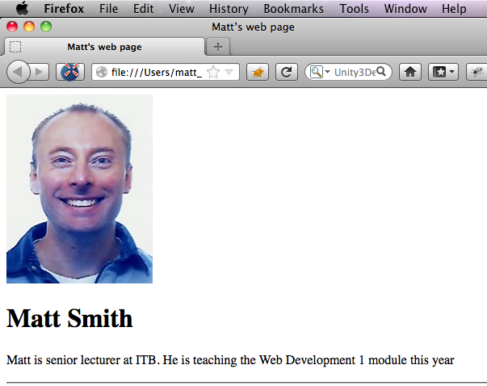
Anatomy of a Web Page
Now a brief look at what an HTML page looks like.
We’ll return to the earlier example
This is what it looks like in a browser.

Slide 3
Anatomy of a Web Page
It’s actually made up of two different files:
matt.html
matt.jpg
The first one contains the HTML code.
The second one contains the image.
The one containing the HTML controls everything.
HTML documents are simple text files and can be created in any software program that can edit text.
We will be using TextPad.
Let’s have a brief look at the HTML code.

Slide 4
<!doctype html>
<html lang="en">
<head>
<meta charset="utf-8">
<title>Matt's web page</title>
</head>
<body>
<img src="images/matt.jpg" alt="picture of Matt”>
<h1>Matt Smith</h1>
<p>
Matt is senior lecturer at ITB.
He is one of the Web Dev 1 lecturers this year.
</p>
<hr>
<footer>Copyright 2012</footer>
</body>
</html>

Slide 5
<!doctype html>
<html lang="en">
<head>
<meta charset="utf-8">
<title>Matt's web page</title>
</head>
<body>
<img src="images/matt.jpg" alt="picture of Matt”>
<h1>Matt Smith</h1>
<p>
Matt is senior lecturer at ITB.
He is one of the Web Dev 1 lecturers this year.
</p>
<hr>
<footer>Copyright 2012</footer>
</body>
</html>

Slide 6
Mark-up: content and tags
Note that it consists of two things:
1. The textual content of the page (“Matt is senior” etc.)
2. Special tags that describe each text element
These tags are core to everything in Web Development.
Tags are always enclosed by angle brackets (< and >)
Examples:
<html>
<img>
<p>

Slide 7
HTML = HyperText Markup Language
Adding these descriptive tags to a document is known as “marking up” the document.
Web pages use a markup language called HyperText Markup Language (HTML for short)
HTML contains dozens of tags that allow us to:
Mark text elements as being headings, paragraphs etc.
Mark text elements as being links
Add information about the document (its title for example)
Add media such as images
Mark up GROUPS of elements
Page header / footer / navigation bars

Slide 8
Read through the HTML and try and match tags with what appears in the browser.
You should note the following things ..
Firstly the text inside the tags does not display on the final page (<body> for example).
This is because they are instructions to the browser (markup), not content.
Secondly, note that most of the tags occur in pairs.
<h1>Matt Smith</h1>

Slide 9
“beads on a string”
On way to think of the way the special HTML characters work is that they follow a special pattern sequence
Like a bracelet with a pattern made from beads on a string
Matt Smith
<
<
h1
>
/
h1
>

Slide 10
An example involving 4 files

Slide 11
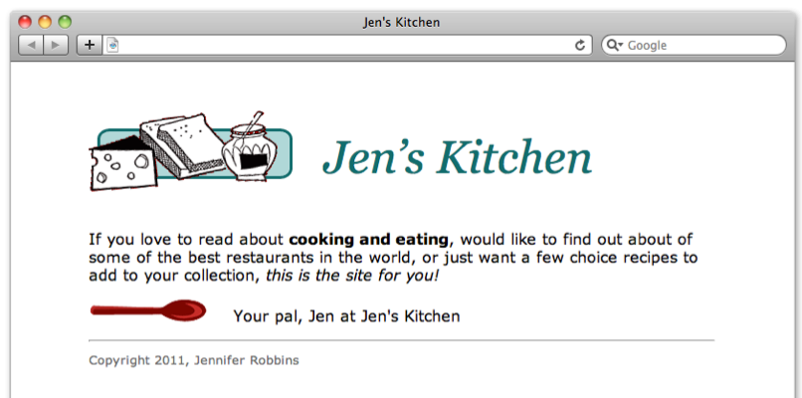
This Jen’s Kitchen page shows text, 2 images, and has been styled from a CSS style sheet file
(from the recommended book …)

Slide 12
Where do the CSS style rules come from?
Where do the images come from?
there are no images in the HTML file
So where are the pictures?
And how does the browser know which pictures to put where when it draws the web page?

Slide 13
Telling browser to fetch a CSS file
Remember for the image the browser had to make another REQUEST to the server for the image file ….
Same thing happens when browser sees <link> or @import in the <head> part of the HTML document
It makes ANOTHER request to the SERVER asking for that CSS stylesheet text file
E.g.
<style>
@import "style.css";
</style>

Slide 14
Telling browser to fetch an image
Look inside the <img> elements to see how the browser knows which image files to request from the server
<img src="images/kitchen.gif" alt="Jen's Kitchen banner">
<img src="images/spoon.gif" alt="spoon illustration">
So Google Chrome browser has to make 2 MORE requests to the SERVER asking for images:
kitchen.gif
spoon.gif

Slide 15
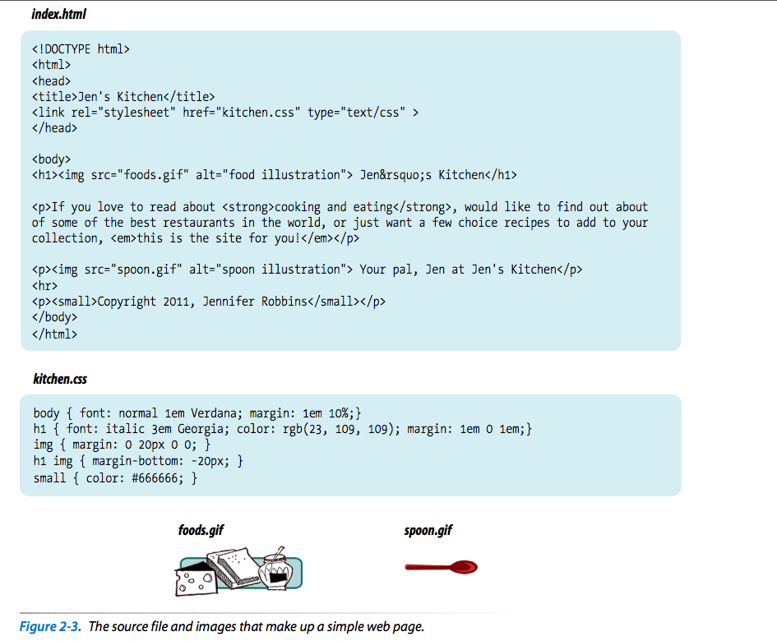
1
There are
4 files
<style> @import "css/kitchen.css"; </style>
</head>
2
3
4

Slide 16
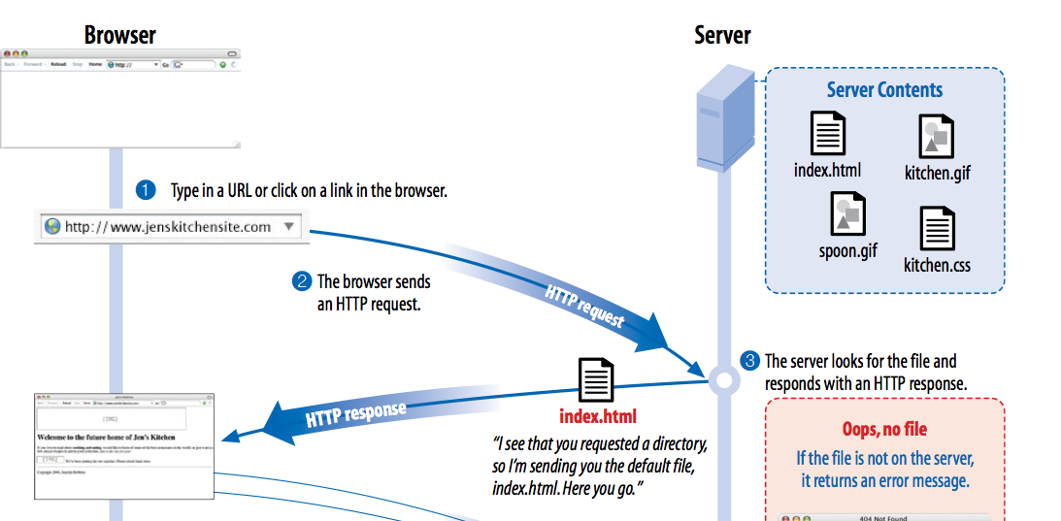
Browser REQUEST to Server – receive HTML
The dreaded 404 error!

Slide 17
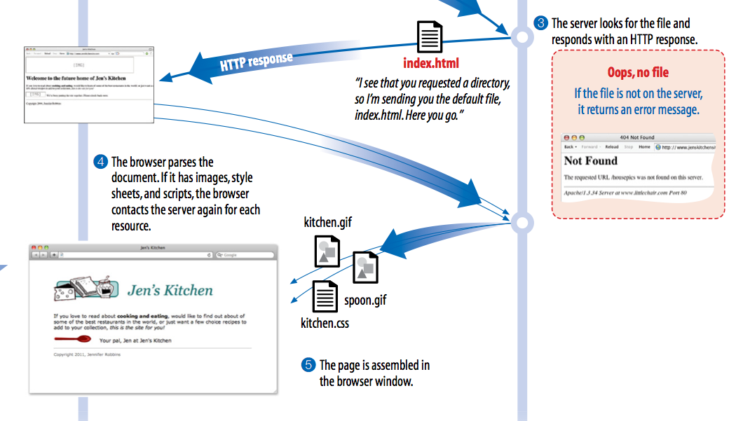
Browser parse HTML, make more REQUESTs to Server – to receive CSS, images, JS, etc.

Slide 18
See browser – server messages
and file communications
using Google Chrome dev. Tools ..

Slide 19
Modern browsers provide DEVELOPER TOOLS to help technical web developers (like US!)
Google Chrome provides some great web developer tools built-in to the browser:
Choose menu:
Tools | Developer tools
Then click network
And you can SEE the HTTP requests from browser
And you can SEE the HTTP responses received from server
Timing information, method (GET or POST), content of messages received etc.

Slide 20
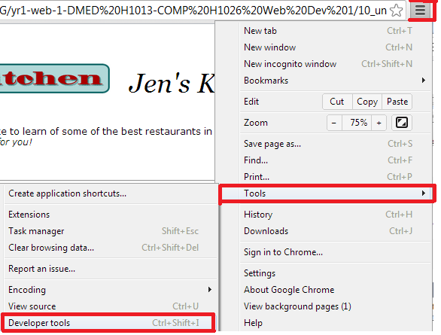

Slide 21
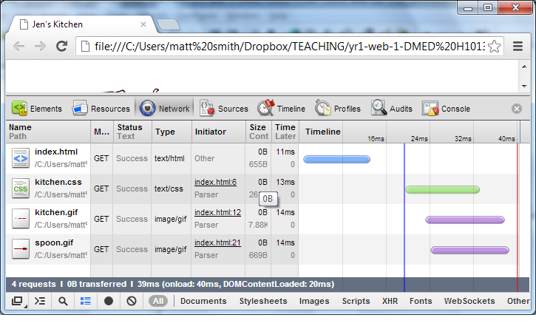
HTML
CSS
images
We see the 4 files received: index.html loaded first (in 11ms)
kitchen.css (just over 32ms), then 2 images loaded in parallel …

Slide 22
BLOCK level and
INLINE page elements

Slide 23
BLOCK LEVEL and INLINE elements
BLOCK LEVEL elements
BLOCK level elements start on new lines and do not run together
E.g. heading and paragraph elements
Browsers treat block-level elements like they are enclosed in rectangular boxes, stacked up on the page.
Each one begins on a new line and there is space above and below it.

Slide 24
BLOCK LEVEL and INLINE elements
INLINE elements
INLINE elements do NOT start a new line
they stays within the flow of the paragraph
look at text marked up as emphasised (em).
For example, weakly emphasises elements <em>
Inline elements do not start new lines, they continue the flow

Slide 25
Step 3: Identify Text Elements
BLOCK LEVEL & INLINE elements
Next slide shows the page with:
Block level elements on a blue background
inline elements on a green background
Note the space that the browser automatically places around the block elements.
Learn more about BLOCK level and INLINE in next few lectures … simply but important distinction …

Slide 26
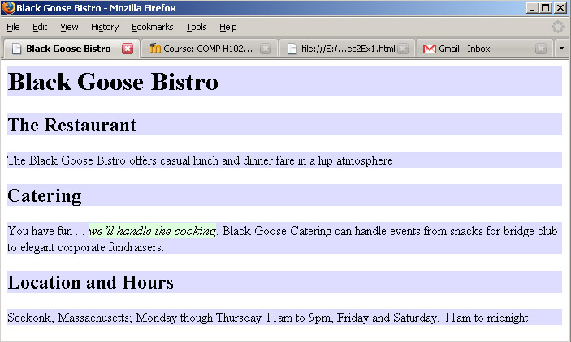
Step 3: Identify Text Elements
BLOCK LEVEL elements on a blue background
INLINE elements on a green background

Slide 27
Summary and Conclusions

Slide 28
Summary / Conclusions …
HTML: Language to mark-up text content
Also to indicate what other files the browser needs to request from the server: CSS rulesets, images etc.
HTML mark-up
Elements made up of TAGS + CONTENT
<h1>Chapter 1</h1>
Content: “Chapter 1”
Beginning and ending tags: <h1> </h1>
Tags + content make up an ‘h1’ element in the document
Web page composed of multiple files
HTML, CSS, images etc.)
BLOCK level and INLINE elements in a page

